Slide 1
Analysis of Graduation Rate Predictors in CPS High Schools
Max Barry
Jan. 25th, 2019

Slide 2
Motivation
Chicago Born, Bred,
and Educated
Experience with Chicago Education Organizations

Slide 3
Motivation
After isolating strong predictors of graduation rates in CPS high schools, educators and educational administrators will be able to improve the quality of Chicago public education.
A strong public education system is a structural pillar of a healthy society.

Slide 4
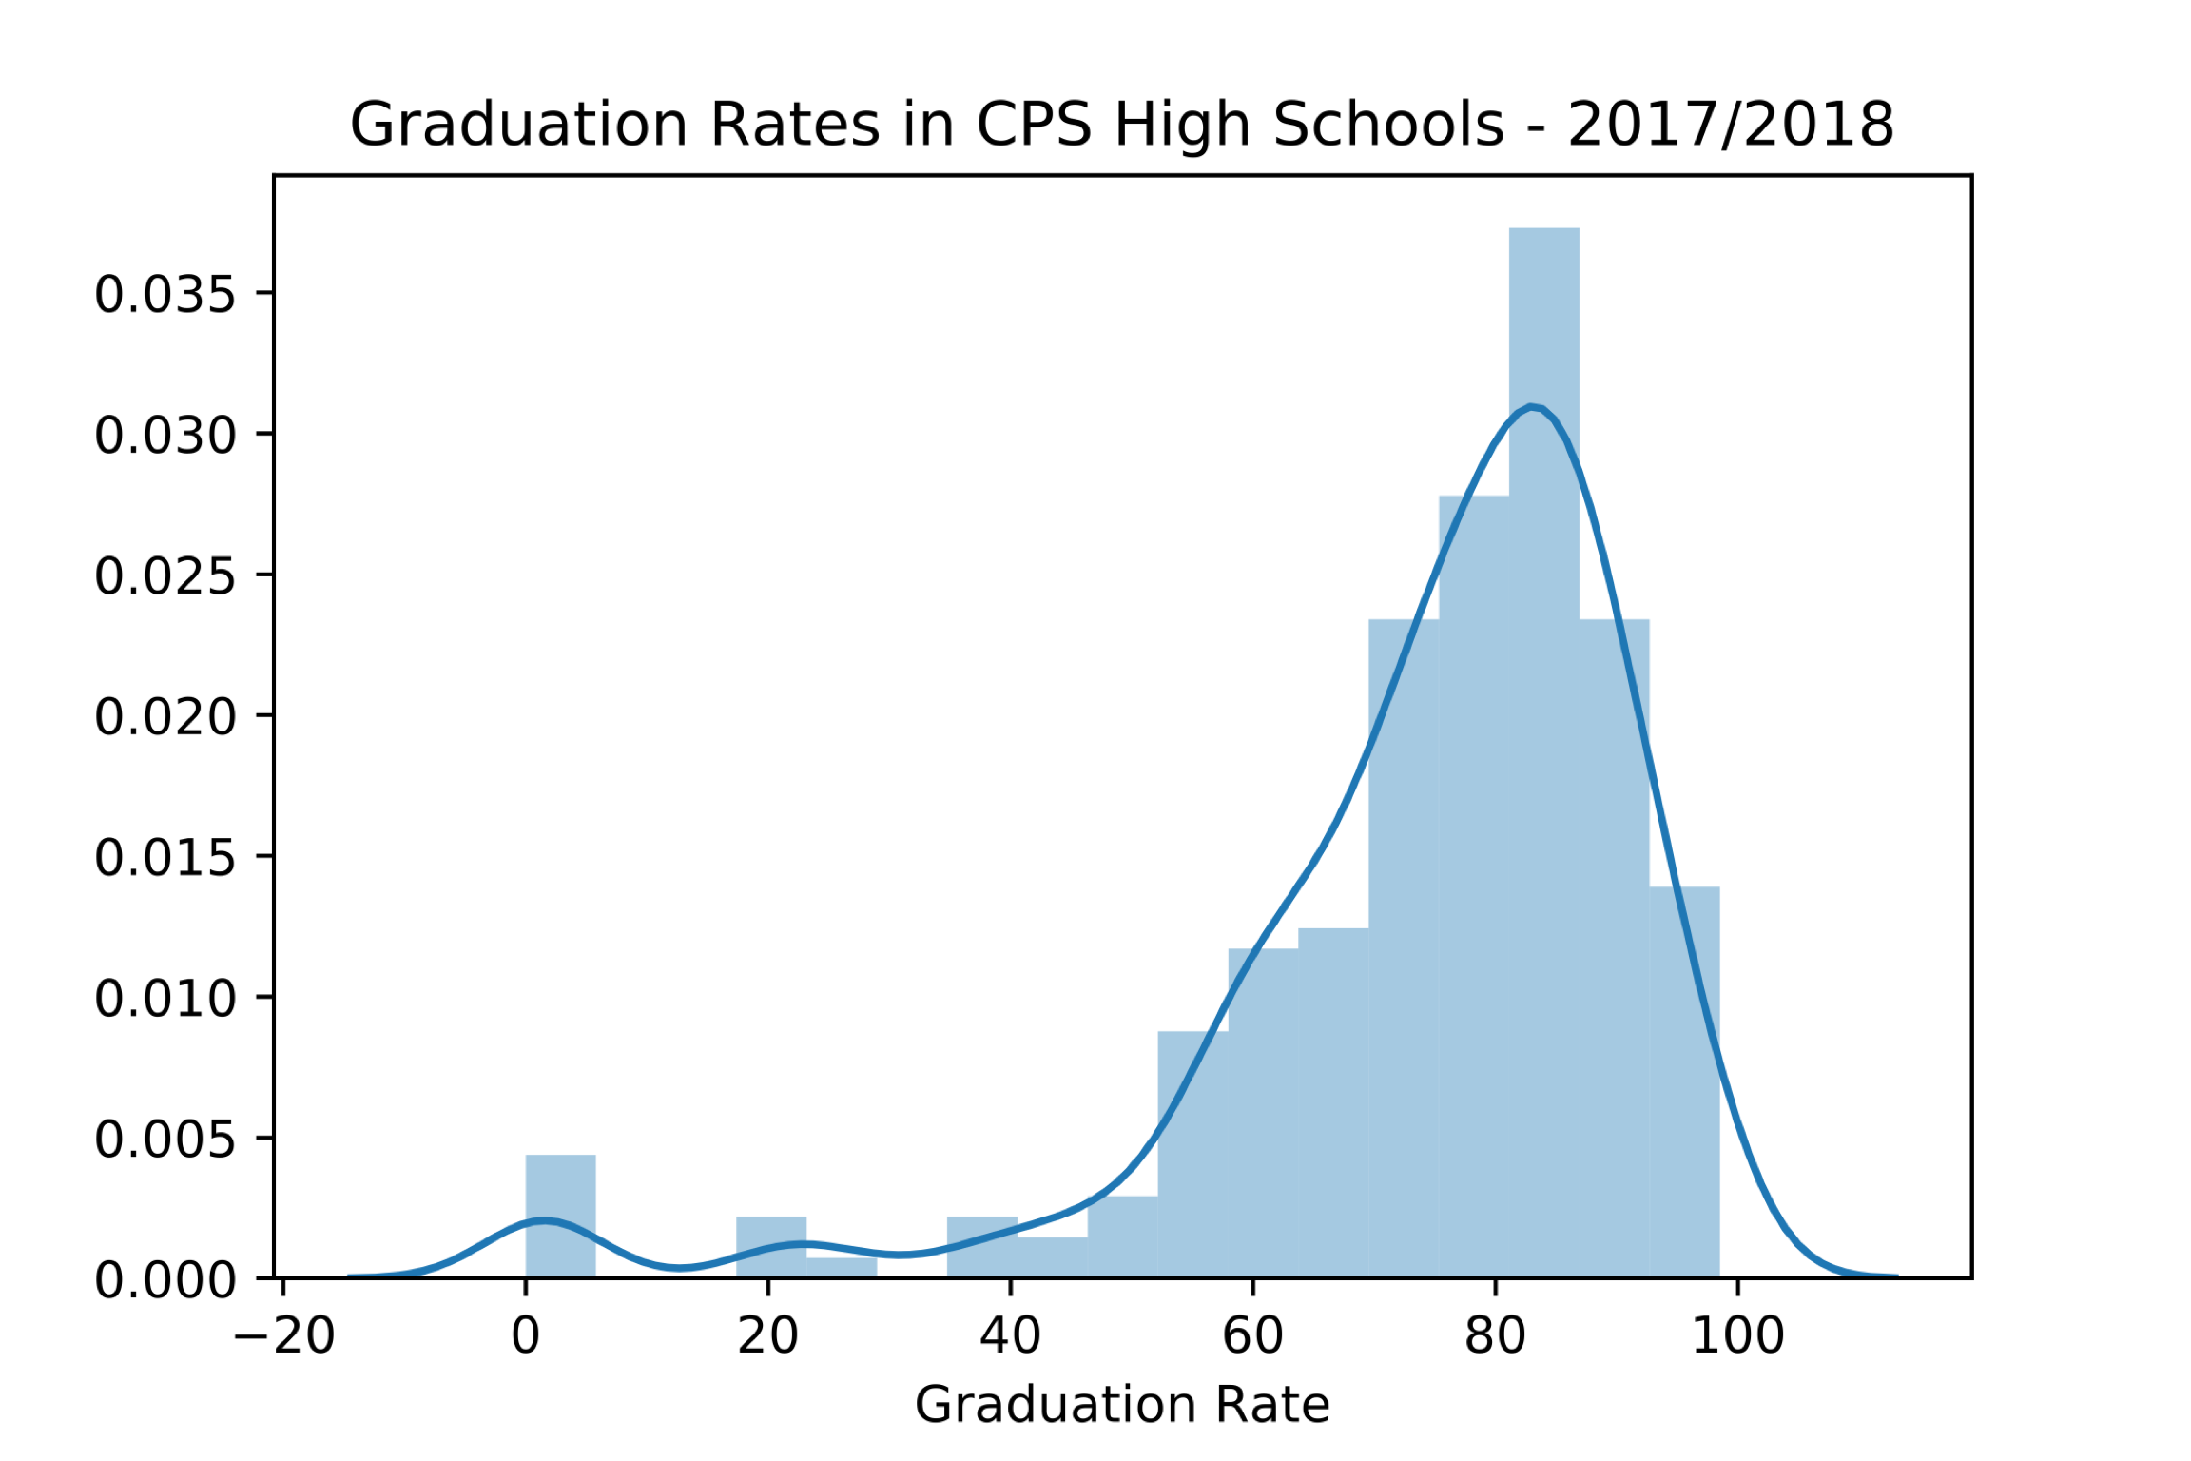
Data
118 high schools
2 years: 2016-17, 2017-18
29 features from the reports
Transformed data:
gender of admin, language count, grade count
Data Source: Chicago City Data Portal school progress reports
Income stats from zip census.gov

Slide 5
Technical Methodology
Linear regression
LASSO
KFold validation
r-squared & root mean squared
LARS
Reflected and log transformed graduation rates

Slide 6
Results
Classroom Languages
Total Students
Dress Code
Purple Line
Charter
Fully Accessible
Ethnicity Not Available
Green Line
Hawaiian Pacific Islander
Red line
Special ed. S.C.
African American S.C.
Low income S.C.
Grades offered
Eng. Lang. learners S.C.
Hispanic S.C.
Blue line
Higher
Graduation Rate
Lower

Slide 7
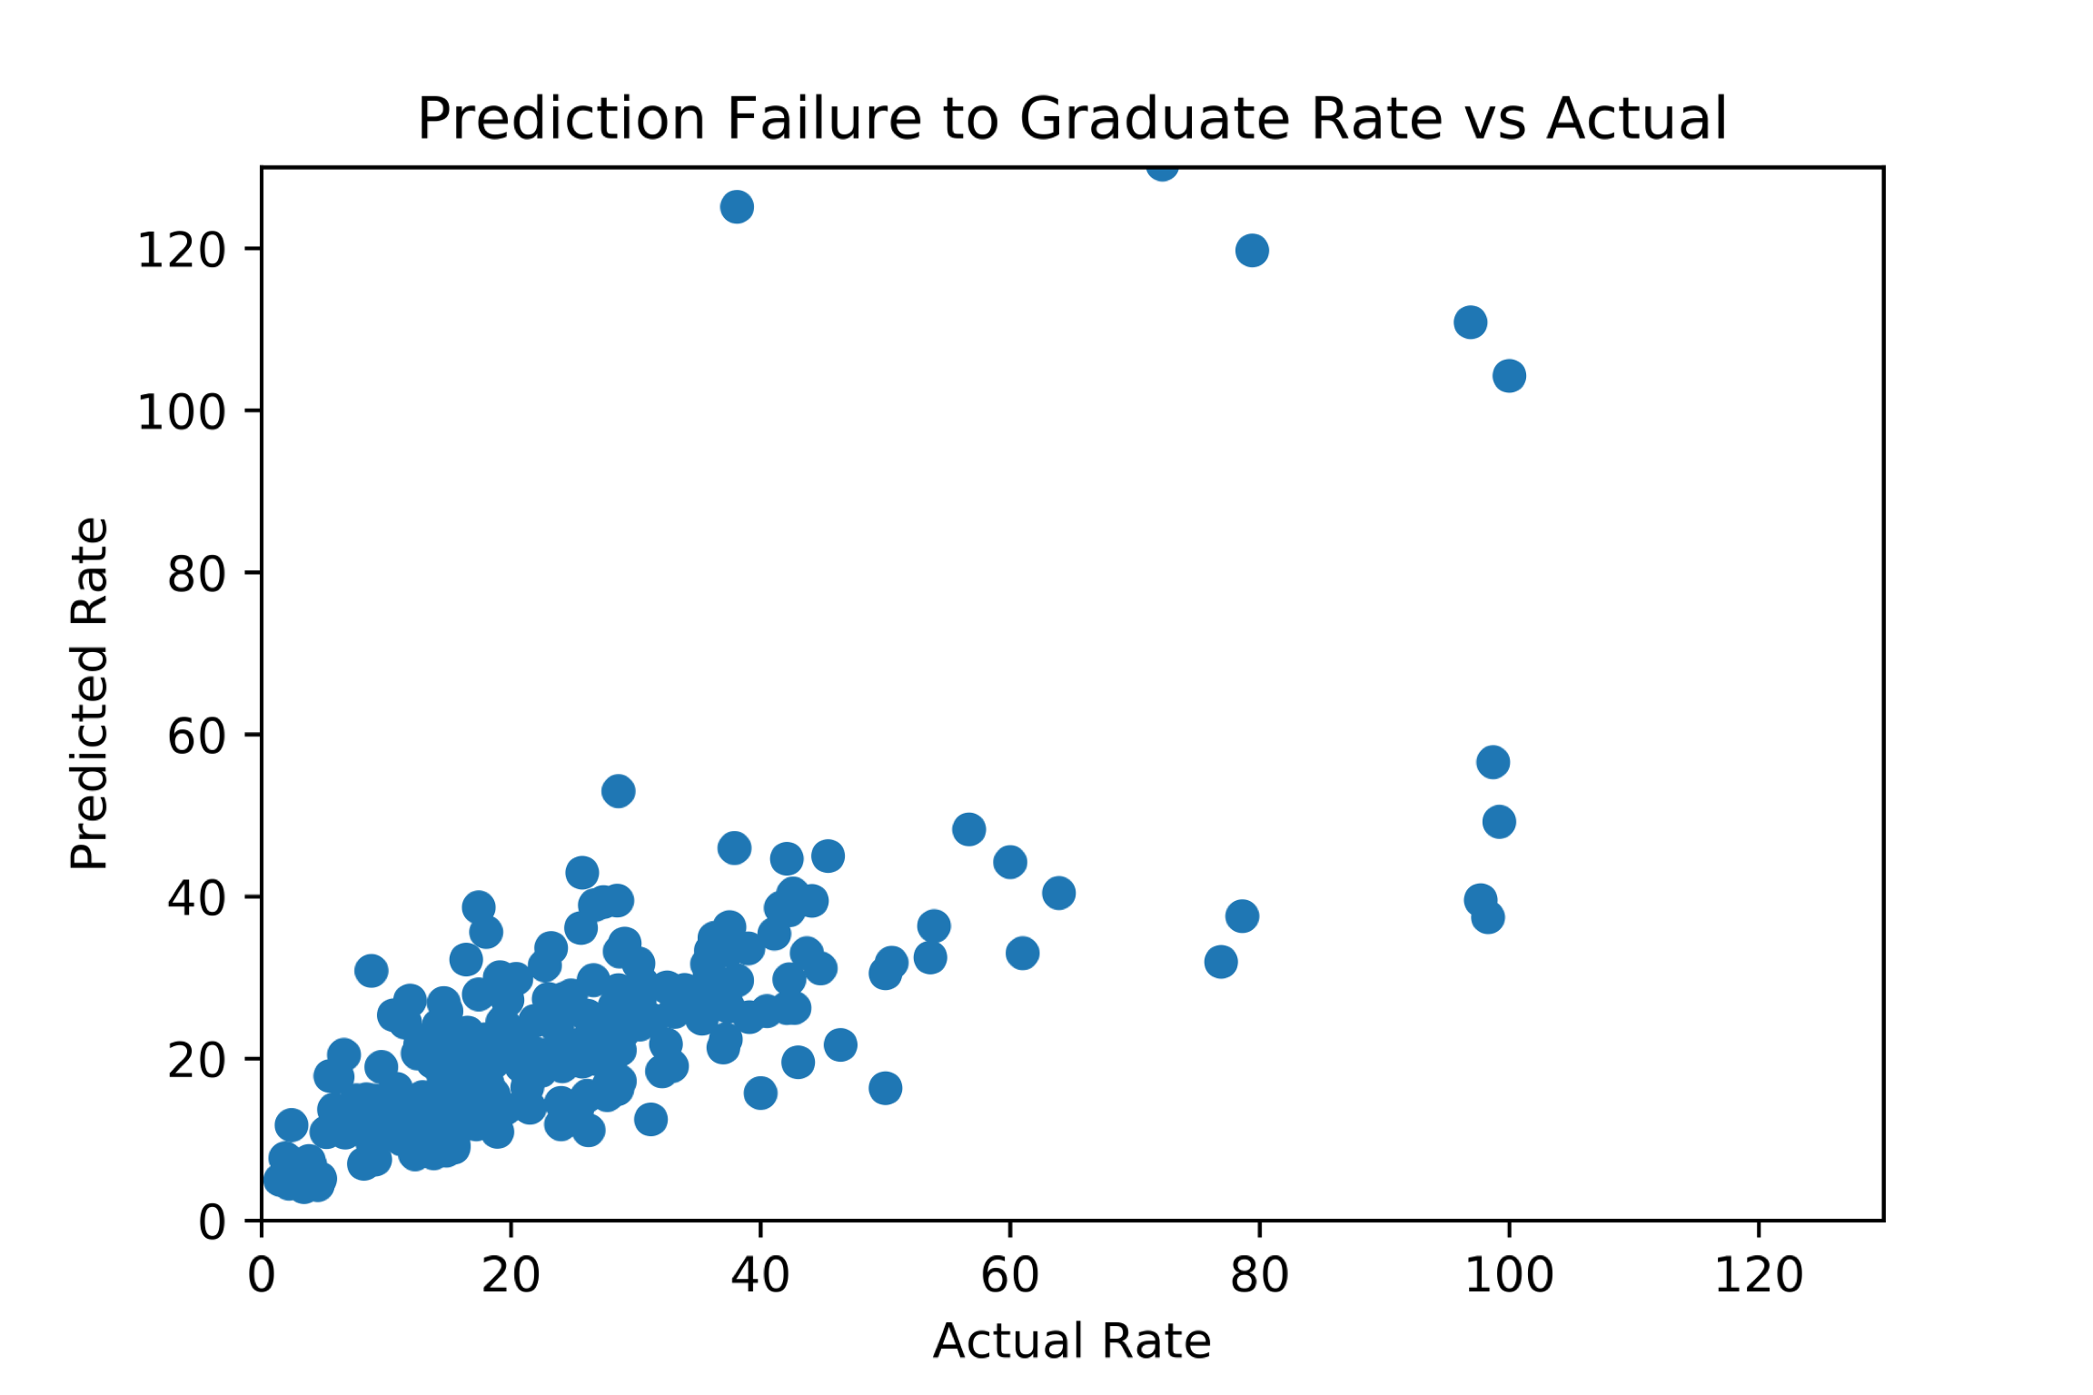
Results
Validation r-squared: .429
Train r-squared: .605
RMSE: 17.765
Imaginary School
Students: 800
Fully Accessible: Y
`. Am. Perc: .1
ELL: ..05
Hispanic: .25
Low Inc.: .4
Special Ed: .1
Classroom Languages: 3
On the Blue line, dress code,
4 grades offered, not Charter
Predicted Graduation Rate:
91.6 %

Slide 8
Conclusions
Populations
Specific racial and income distributions have large effect on graduation rate.
Larger student body has a positive effect, but more grades offered has a negative effect.
Administrative decisions have a positive impact:
full accessibility, dress code, languages offered.
but administrator gender cannot be shown to have impact.
Nondeterminate indicators
Mean income by zip, general accessibility, Asian and white demographics, and accessibility to Brown, Orange, Pink lines

Slide 9
Future Work
Expanded data set:
Further into the past
Private schools
Additional features
After school programs
Arts programs
Proximity to resources
Subject focus
Student/teacher ratio
School day/after school hours
Comparisons
Suburbia
Other large cities
Other countries

Slide 10
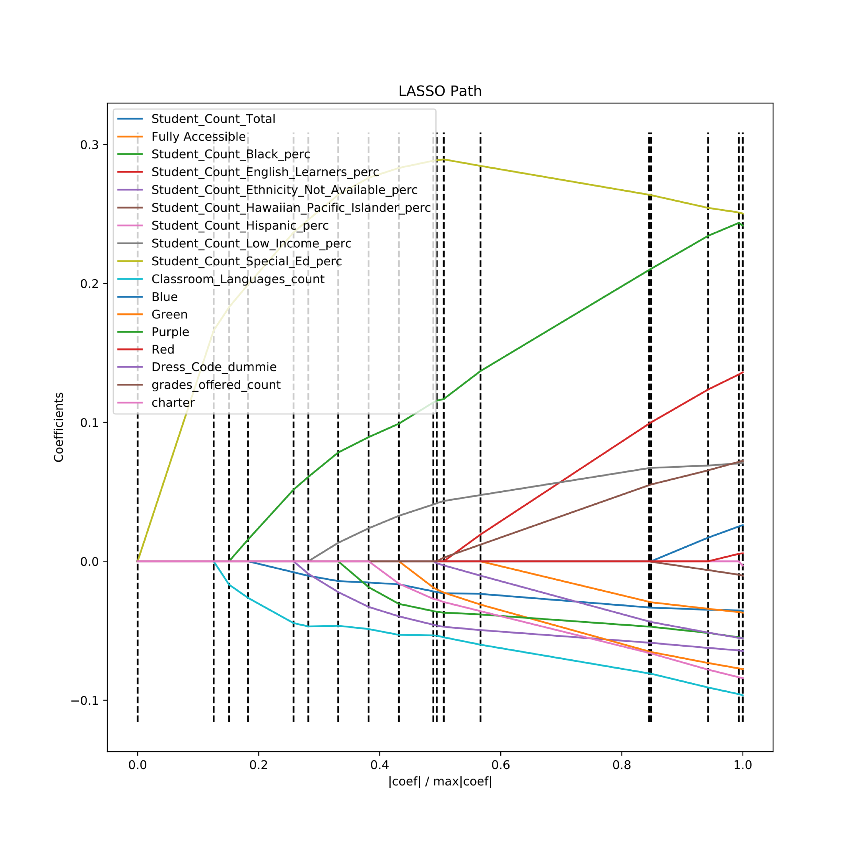
Appendix

Slide 11
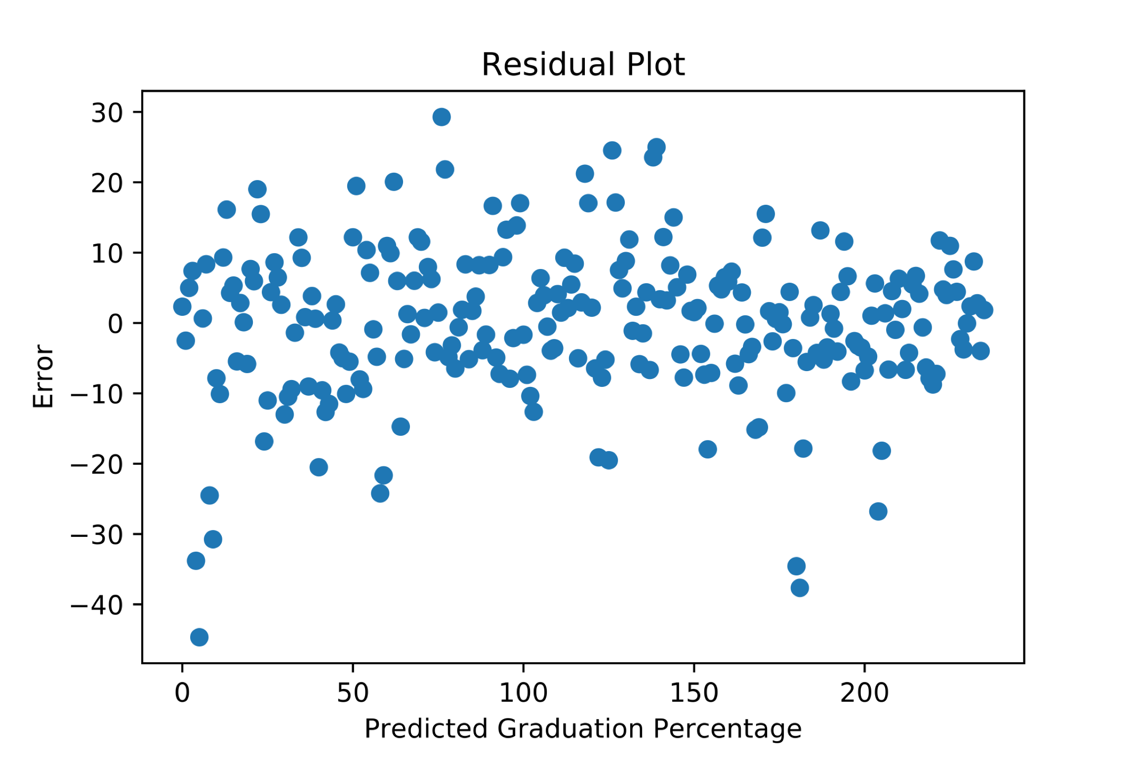
Appendix

